Slide 1
Telephone skills and social media

Slide 2
Objectives
To understand the best way to use the telephone
To feel confident in ‘cold calling’
To explore ways to practise speaking to people over the phone
To discover how you can use social media to search for jobs
To discover how social media can work against you

Slide 3
Phone calls
Notes:
IN PERSON – Get everyone in the group to get their phones out. This may be against what you have agreed in the ground rules.
Get everyone to check who their last call was from and go round the group.
Start a discussion: Do you answer calls from unknown numbers or numbers you do not recognise?
Do you have a voicemail? What is it like?
Lead the group in discussing why they should answer any call they get. Lots of companies call from unknown numbers. People will leave messages about jobs if they are unavailable.

Slide 4
Answering the phone

Slide 5
When we use the phone to make a call
To find out information
To call professionals such as a GP
Interviews
To contact local services
Emergency
To contact employers to find unadvertised jobs

Slide 6
How to make that call
Prepare for the call
Standing up gives you better voice projection.
Smiling can affect the tone of your delivery.
Explain your call – who you are and the reason you are calling.
Have some questions prepared and listen to the answers.
Match yourself to the needs they express. If you listen carefully, you will pick up clues for this.

Slide 7
Techniques to practise
Be persistent.
Be positive.
Maintain control.
Be polite.
Nobody plans to fail – they just fail to plan.

Slide 8
The importance of listening
Ask questions ensuring you have understood what has been said.
Do not interrupt. Let the person finish talking.
Think about what your contact is saying.
Let them know you are listening.
Try not to worry about other people’s opinions.
Keep an open mind.
Have everything ready before you call.
Listen to all they have to say before you make any decisions.

Slide 9
Activity 1
The job advert and phone call
Notes:
IN PERSON - This activity will depend on the number of participants. You will need 2 mobile phones and a trainer or learning support assistant to be ‘Caroline Jones’. Go to another room. Each participant then needs to make a call to Caroline asking about the vacancy, whether it is full-time or part-time and to request an application form.
Get participants to plan what they are going to say. Take turns in calling ‘Caroline Jones’. Once everyone has had a turn, gather feedback for each participant. This can feed into their personal action plan.
You have seen an advertisement in the paper for a job you would like to apply for.
The job advertisement states that you need to telephone for an application form.
There is no detail of whether this is a full-time or part-time vacancy.
Telephone to ask for an application form and ask how many hours a week this vacancy is for?

Slide 10
What else can you use a phone for?
Telephone skills are important to practise and build your confidence when job searching.
But phones are great tools for other parts of job searching.
What else can you use a phone for when looking for work, volunteering or training?

Slide 11
Activity 2
Social media

Slide 12
Top social media for job searches
Facebook – 2.9 billion active users
Instagram – 2 billion active users
LinkedIn – 900 million active users
Twitter – 556 million active users
Notes:
Stats are for 2023 from Statista
LinkedIn stats are from 2023

Slide 13
Activity 3
Why is social media important in the world of work?

Slide 14
Why use social media in job search?
Around 91% of UK employers say they use social media as part of their hiring process.
The social networks that employers use most are:
LinkedIn – 91%
Facebook – 66%
Twitter – 53%
Notes:
2023 UK stats from Standout CV

Slide 15
Facebook
Ask your friends if they know any employers that are hiring.
Use the search function to look for local jobs.
Like pages of employers you’re interested in working for.

Slide 16
Twitter
Follow employers you might want to work for.
Search hashtags
#Job is a good way to see jobs posted. You might need to narrow down the search to UK or local area only #job.
As Twitter is a global network, it is best to search in times when local companies would be posting jobs between 9 am and 5 pm.

Slide 17
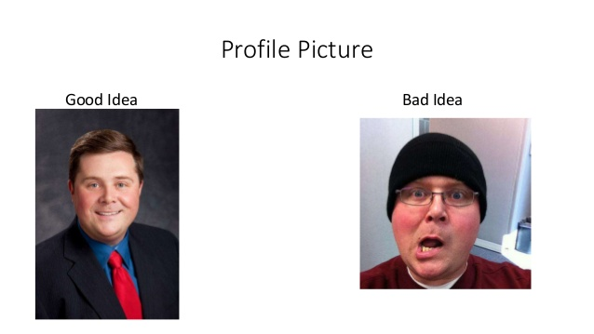
Profile photo

Slide 18
Profile tips for LinkedIn
Skills and expertise
Summary
Experience
Education

Slide 19
Job searching on LinkedIn
LinkedIn has a job search function.
You can follow a company on LinkedIn, meaning all their news, including the jobs they advertise, come up in your news feed.
You can message contacts and companies on LinkedIn to find out more about vacancies.

Slide 20
Activity 4
How might social media have a negative effect on work?
Notes:
Examples to use as a discussion point with the group.
Tribal Impact – 7 employees that ‘got it wrong’ on social media. Or did their employer? March 2021
AWH Solicitors article – Social media misuse can get you in serious trouble – February 2022
My HR Dept – Employee dismissed for Facebook posts
The Muse – Yes, you can get fired for your social media posts: 9 times people learned this lesson the hard way – June 2020

Slide 21
Most common social media errors job seekers make
75% use offensive language in posts and content
70% refer to drug usage
47% drunken behaviour
29% political activity
Notes:
https://standout-cv.com/pages/job-search-statistics-uk

Slide 22
Social media tips for your job search
Read or check social media policies.
Be consistent in your name.
Google yourself.
Request your Twitter archive.
Check your passwords are secure.
Notes:
Scope’s social media policy
SplashData (2022) – 100 Most Common Passwords of 2022

Slide 23
Reviewing your actions
It's important to review your action plans regularly.
Ask yourself the following questions:
Has the goal been achieved or changed?
Which steps were achieved and why?
Which steps were not met and why?
If you were doing it again, what would you change?

Slide 24

Learn at Scope

Slide 25
What is Learn at Scope?
Learn at Scope is Scope’s eLearning platform.
It is exclusively for Scope customers and offers further support to achieve your goals.
As it’s a digital resource you can use it on your home computer, on a tablet or on a smartphone.
It is available 24 hours a day.

Slide 26

Scope job board

Slide 27
What is the Scope job board?
The Scope job board is exclusive for Scope customers.
It advertises job vacancies with Disability Confident employers.
It has a range of job sectors and job types.
It is available 24 hours a day and is updated regularly.

Slide 28

How to use the Scope job board
Notes:
Play from https://www.scope.org.uk/advice-and-support/jobs-board-video/

Slide 29

Feedback
Let us know what you think so far

Slide 30
Thank you

